Slide 1

Pseudoalignment for Metagenomic Read Assignment
Xiyuan Jiang
Cong Peng
Notes:
This paper main explores the connection between metagenomics read assignment and the quantification of transcripts from RNA-Seq data. In particular, it shows that the recent idea of pseudoalignment introduced in RNA-Seq context is suitable in the metagenomics setting.
As for me, this paper is a summary of most of the state of art programs in discussing the read assignment technology in bioinformatics. It summarizes the performance of these programs and analyze the pros and cons of each programs, which is already discussed in detailed throughout this course.

Slide 2
Outline
1. Introduction
2. Methods and results
3. Demonstration
4. Conclusion
5. Q&A
Notes:
So lets get it started on the introduction.

Slide 3
Outline
1. Introduction
2. Methods and results
3. Demonstration
4. Conclusion
5. Q&A

Slide 4
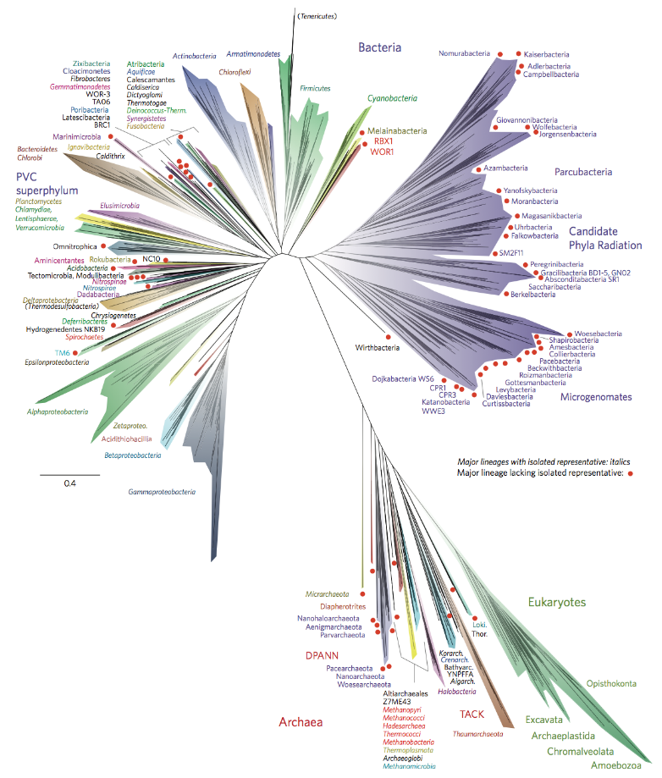

Introduction of metagenomes
Metagenomics is the study of genetic material recovered directly from environmental samples.
Notes:
One of the presentation has already covered the introduction in metagenomics and just to refresh your mind and I will try to recap that in brief.
We may ask the question how can we analyze individual genomes, and how to classify them? Since for real data, it might contain various amounts of bacteria, those we already studied, those we haven’t studied much, those we can’t give them a name or those we even don’t know their existence.

Slide 5
Core problem in metagenomics
Notes:
One of the fundamental metagenomics problems that is amenable to reference-based analysis is that of \sequence classication" or \read assignment". This is the problem of
assigning sequenced reads to taxa.
The main idea in metagenomics is to assign sequenced read to taxa.
Lets give a pause and turn to taxanomy. Here we observe a red fox, but I don’t know why it is colored in white, it doesn’t matter, so be it. We can see that the red fox we observed is classified into eight level of ranks which are … and at the bottom level, species. it turns out to be a vulpes.
So here is the thing, can we apply the programs which are proved to perform well in the RNA-Seq also suitable for metagenomics setting. To answer this question, we will first give a comparison between metagenomics and RNA-Seq.

Slide 6
Programs comparison
Program | Pros | Cons
MEGAN^{[1]} | Assign reads to lowest taxonomic level Powerful visualization toolkit | Ambiguous mapping reads ignores individual strains Computation problem
Kraken^{[2]} | Instead of read alignment, k-mer hashing | Speed at a cost
Kallisto^{[3]} | More accurate Faster(“negligible”) | (currently not found in the paper)
Other related work: eXpress, CLARK, GASiC, GRAMMy……
[1]Huson, D. H., Auch, A. F., Qi, J., and Schuster, S. C. (2007). MEGAN analysis of metagenomic data. Genome research, 17(3):377–386.
[2]Wood, D. E. and Salzberg, S. L. (2014). Kraken: ultrafast metagenomic sequence classiﬁcation using exact alignments. Genome Biology, 15(3):R46.
[3] Bray, Nicolas L., et al. "Near-optimal probabilistic RNA-seq quantification." Nature biotechnology 34.5 (2016): 525-527.
Notes:
MEGAN:
It provided a phylogenetic context to mapped reads by assigning reads to the lowest taxonomic level at which they could be uniquely aligned, and became popular in part because of a powerful
accompanying visualization toolkit.
Unfortunately, these approaches all relied on read alignment, a computational problem that is particularly difficult in the metagenomic setting where reference genome databases are
large and read sets gigantic.
Kraken:
In a breakthrough publication in 2014 [Wood and Salzberg, 2014] it was shown that it is possible to greatly accelerate read assignment utilizing fast k-mer hashing to circumvent the need for read alignment.
analyses that previously took hours were tractable in minutes, and the removal of the read alignment step greatly simplied workows and storage requirements.
However, An examination of the Kraken algorithm and output reveals that the method takes a step back from GRAMMy and GASiC by discarding statistical assignment of reads at the strain level in favor of direct taxonomic assignment as in MEGAN

Slide 7
Apply RNA-Seq methodology to metagenomics
Origin: Statistical methods^{[4]} for identifying diﬀerential abundances in microbial marker genes.
[4] Paulson, J. N., Stine, O. C., Bravo, H. C., and Pop, M. (2013). Diﬀerential abundance analysis for microbial marker-gene surveys. Nature methods, 10(12):1200–1202.
Notes:
The idea of translating RNA-Seq methodology to metagenomics was, to our knowledge, first proposed in
A natural question to ask is whether it is possible to leverage fast k-mer based hashing to map reads not at the taxonomic but at the strain level, while assigning the resulting ambigously mapped reads using a statistical framework that allows for probabilistic assignment of reads.
The idea of translating RNA-Seq methodology to and from metagenomics was, to our knowledge, first proposed in Dierential abundance analysis for microbial marker-gene surveys. Nature methods , 10(12):1200{1202.
In that paper,there were comparisons between the proposed metagenomics method and RNA-Seq differential analysis methods implemented in DESeq [Anders and Huber, 2010] and edgeR [Robinson et al., 2010]

Slide 8
Metagenomics vs RNA-Seq
 | Metagenomics | RNA-Seq
Similarity | Assign genomic reads into a specific group
Difference | Map reads at a strain level Genomic sequences are larger Reference database less complete | Map reads to a specific isoform Transcripts are relatively small Reference database well established
Notes:
Similarity
There are many researches done in RNA-Seq it is an experiment for which there has been extensive methods development that we hypothesized could be adapted and applied to metagenomics.
However, …

Slide 9
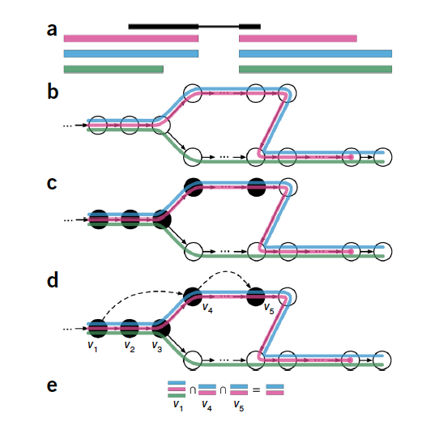
Pseudoalignment
Basic idea of kallisto (pseudoalignment)
Notes:
method based on pseudoalignment of reads and fragments, which focuses only on identifying the transcripts from which the reads could have originated and does not try to pinpoint
exactly how the sequences of the reads and transcripts align.
We then turn to the page of kallisto which introduces the pseudoalignment in RNA-Seq quantification.

Slide 10
Outline
1. Introduction
2. Methods and Results
3. Demonstration
4. Conclusion
5. Q&A
Notes:
Lets move on the methods used in this paper and evaluates the results using metakallisto

Slide 11
Methods and Results
1. Hypothesis test: RNA-Seq quantification can be applied in he metagenomics setting.
2. Performance evaluation: meta-kallisto performs better than state-of-the-art algorithms.
Notes:
There are two parts we are going to discuss, and I will cover the first part which is the hypothesis test and leave xiyuan to continue our presentation.

Slide 12
1. Hypothesis test
Hypothesis: RNA-Seq quantification methods can be applied in the metagenomics setting
Validation: Exam the performance of eXpress^{[5]}.
Reasons to choose:
a) eXpress utilizes traditional read alignments directly to a transcriptome.
b) eXpress is more memory efficient than other approaches.
[5] Roberts, Adam, and Lior Pachter. "Streaming fragment assignment for real-time analysis of sequencing experiments." Nature methods 10.1 (2013): 71-73.
12
Notes:
The assumption is quite simple: can we apply RNA-Seq quantification methods into metagenomics setting. The answer is yes and here goes the thorough explanations.
We first examine the performance of eXpress

Slide 13
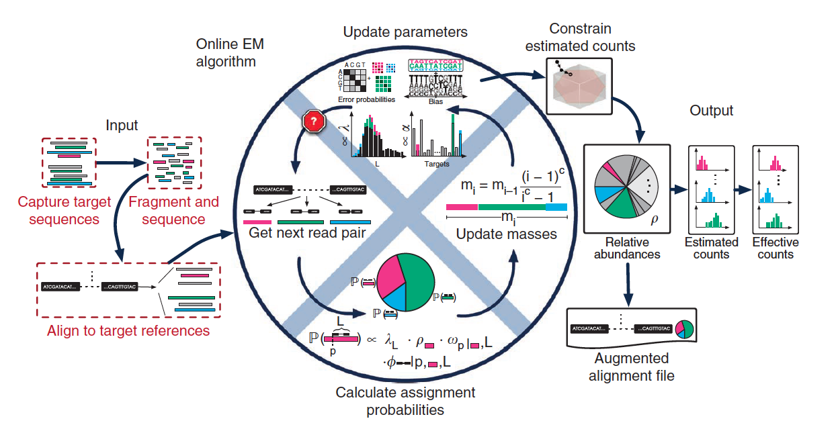
1. Hypothesis test
Overview of eXpress
Notes:
a program that implements a streaming EM algorithm for RNA-Seq read assignment from alignments.
Xpress uses a streaming algorithm with linear run time and constant memory use. It can determine abundances of sequenced molecules in real time

Slide 14
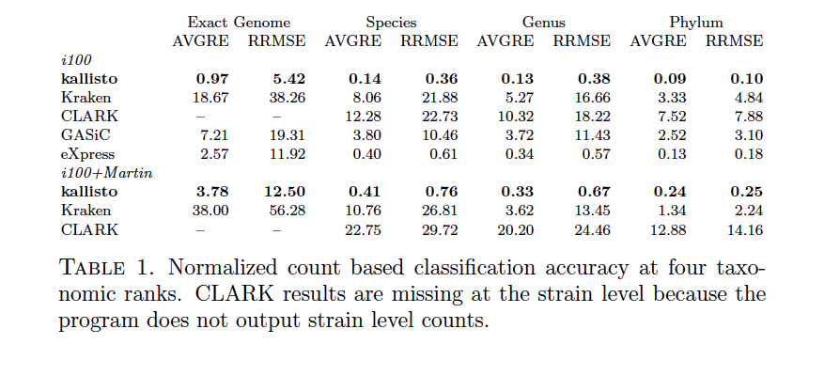
1. Hypothesis test
Dataset: Illumina-like reads from 100 microbial genomes to a reference database^{[6]} containing only those genomes.
Benchmark: GASiC, one method for utilizing read alignments for read assignment.
Taxonomic rank
low
high
[6]Roberts, A. and Pachter, L. (2013). Streaming fragment assignment for real-time analysis of sequencing experiments. Nature methods , 10(1):71{73.

Slide 15
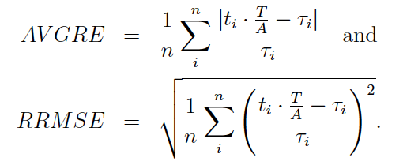
1. Hypothesis test
Note that:
n : number of true genomes/species/genera/phyla
τ_{i} : true counts
t_{i} : estimated counts
A : number of aligned reads
T : number of total reads

Slide 16
1. Hypothesis test
Dataset: Illumina-like reads from 100 microbial genomes to a reference database containing only those genomes.
Benchmark: GASiC, one method for utilizing read alignments for read assignment.
Taxonomic rank
low
high
Major problem for eXpress and GASiC: alignment SLOW!!
Notes:
A major problem with GASiC and eXpress is that the alignments they require are slow to generate. The alignments, made with Bowtie2 [Langmead and Salzberg, 2012],
took days. As reported in [Wood and Salzberg, 2014], Kraken was much faster on the data, taking only 22 minutes 38s.

Slide 17
1. Hypothesis test
Benckmark: Kraken and CLARK
Taxonomic rank
low
high
Mini-conclusion: eXpress outperforms Kraken, GASiC and CLARK.
Notes:
We also tested CLARK [Ounit et al., 2015], another recently published k-mer based assignment tool and, in agreement with the benchmarks in [Lindgreen et al., 2015], we found it to be slightly faster taking 20 minutes 30s. However, as seen in Table 1, both Kraken and CLARK have signicantly worse performance than both GASiC and eXpress (in concordance with [Lindgreen et al., 2015] but in contradiction to [Ounit et al., 2015], we found that Kraken is more accurate than CLARK).

Slide 18
2. Performance evaluation
Algorithms to be compared: kallisto, Kraken and CLARK
A larger and more realistic reference database of 1,958 genomes
Notes:
We next turned to a comparison of kallisto with Kraken and CLARK using the Illumina100 simulation (i100) but utilizing a larger and more realistic reference database
of 1,958 genomes from [Martin et al., 2012]. The results, shown in where the database is called \i100+Martin

Slide 19
2. Performance evaluation
estimated
kallisto
actual
Count
Kraken
CLARK
Phylum
Notes:
We have totally four ranks, Psylum, genus, species and exact genome

Slide 20
2. Performance evaluation
estimated
kallisto
actual
Count
Kraken
CLARK
Genus
Notes:
分图

Slide 21
2. Performance evaluation
estimated
kallisto
actual
Count
Kraken
CLARK
Species
Notes:
分图

Slide 22
2. Performance evaluation
estimated
kallisto
actual
Count
Kraken
CLARK
(No result)
Exact genome
Notes:
分图

Slide 23
2. Performance evaluation
Algorithms to be compared: kallisto, Kraken and CLARK
A larger and more realistic reference database of 1,958 genomes
Notes:
The results show that kallisto is much more accurate than Kraken and CLARK at all four taxonomic levels tested. The performance
of kallisto at the exact genome level is signicantly better than Kraken at the genus level. Notably, Kraken‘s performance at the exact genome level (AVGRE 18.67 and RRMSE 38.26) is too poor to be of practical use.

Slide 24
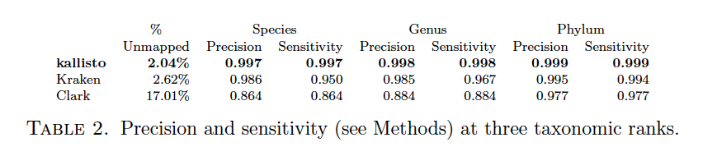
2. Performance evaluation
Algorithms to be compared: kallisto, Kraken and CLARK
A larger and more realistic reference database of 1,958 genomes
Notes:
The running time of kallisto is faster than Kraken with the i100 dataset (5m55s vs 22m38s using a single core) but slower on the i100+Martin (50m55s vs. 27m3s). However
kallisto index building is slightly faster than Kraken, and when utilizing multiple threads for pseudoalignment, kallisto's running time is negligible.

Slide 25
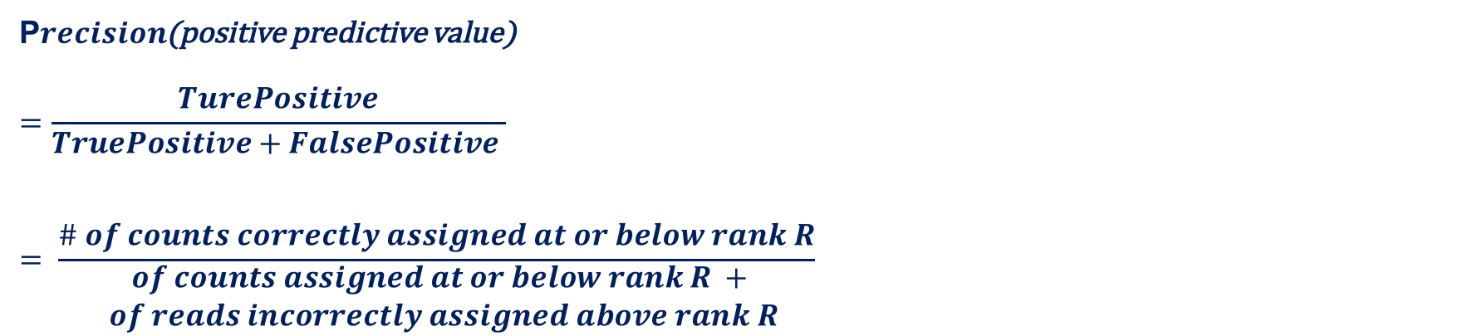
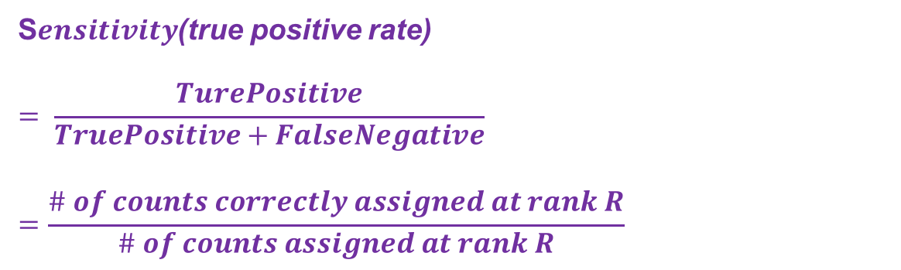
2. Performance evaluation
S$ensitivity$(true positive rate)
$$= \frac{TurePositive}{TruePositive+FalseNegative}=\frac{\# of counts correctly assigned at rank R}{\# of counts assigned at rank R}$$
P$recision$(positive predictive value)
$$=\frac{TurePositive}{TruePositive+FalsePositive }$$
$$= \frac{\# of counts correctly assigned at or below rank R}{\begin{aligned}\# of counts assigned at or below rank R + \\ \# of reads incorrectly assigned above rank R\end{aligned}}$$

Slide 26
2. Performance evaluation
Then the cases of missing strains are examined.
A strain is missing but other similar strains are in the database: removed Bacillus cereus ATCC1 0987, leaving a number of other Bacilii.
A strain distant from others is missing: removed Listeria welshimeri serovar 6b str. SLCC5334, leaving no other Listerias.
Notes:
In essence, strains are mainly variants of a single species

Slide 27
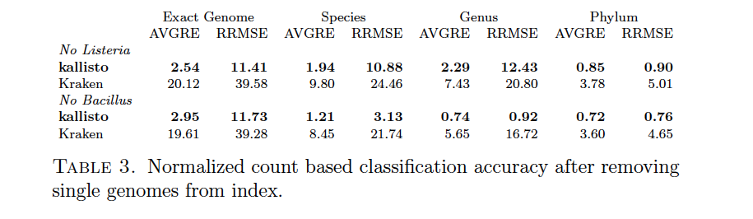
2. Performance evaluation
Then the cases of missing strains are examined.
Without removal
Notes:
As expected, Table 3 shows that the performance of both kallisto and Kraken degrades with removal of strains from the reference database. However, what is interesting is that
in the case of Bacillus, read assignment is still possible at the genus level. In the case of Listeria, the absence of neighboring species means that the reads cannot be assigned. Remarkably, even with a strain completely missing from the reference database, the performance of kallisto is still higher than that of Kraken with all genomes present (compare to Table 1).

Slide 28
Outline
1. Introduction
2. Methods and Results
3. Demonstration
4. Conclusion
5. Q&A

Slide 29
Flowchart
Simulated metagenomic data
Kallisto
transcripts/genomes and their relative abundance
Comparison script
Results: sensitivity, precision, etc.

Slide 30
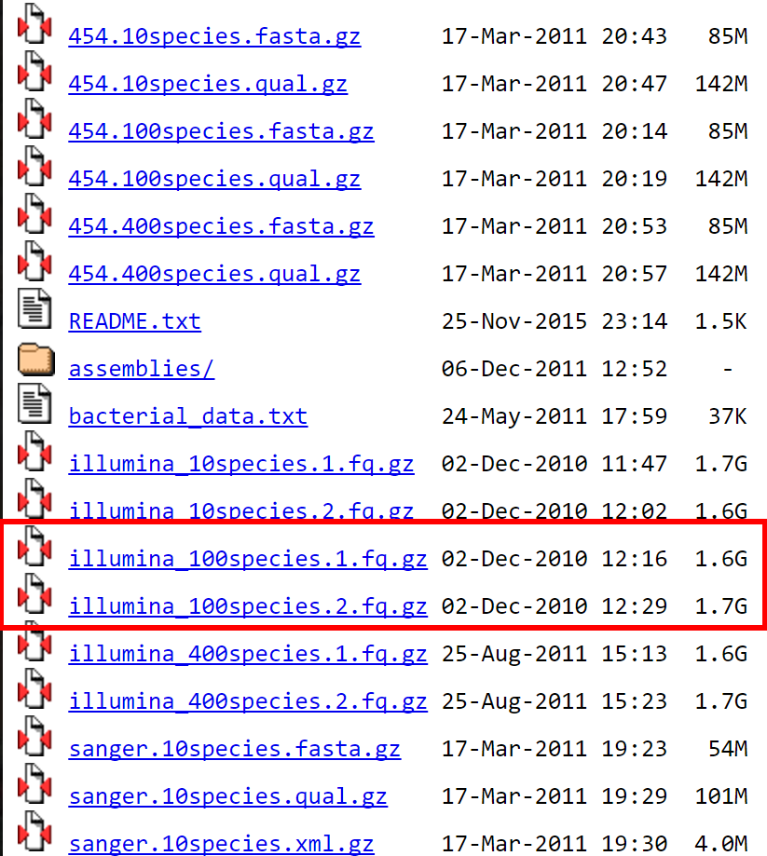
Data simulator
iMESS_Illumina
https://sourceforge.net/projects/cmessi/
Used to generate Illumina100 dataset
http://www.bork.embl.de/~mende/simulated_data/
Mende D R, Waller A S, Sunagawa S, et al. Assessment of metagenomic assembly using simulated next generation sequencing data[J]. PloS one, 2012, 7(2): e31386.
Notes:
cMESSi: A metagenomic simulator for the Illumina sequencing technology
We contacted the author, and he used the available data as well

Slide 31
Data simulator
Available online
Kallisto
https://pachterlab.github.io/kallisto/
Comparison script
https://github.com/pachterlab/metakallisto
Mende D R, Waller A S, Sunagawa S, et al. Assessment of metagenomic assembly using simulated next generation sequencing data[J]. PloS one, 2012, 7(2): e31386.
Notes:
cMESSi: A metagenomic simulator for the Illumina sequencing technology
We contacted the author, and he used the available data as well

Slide 32
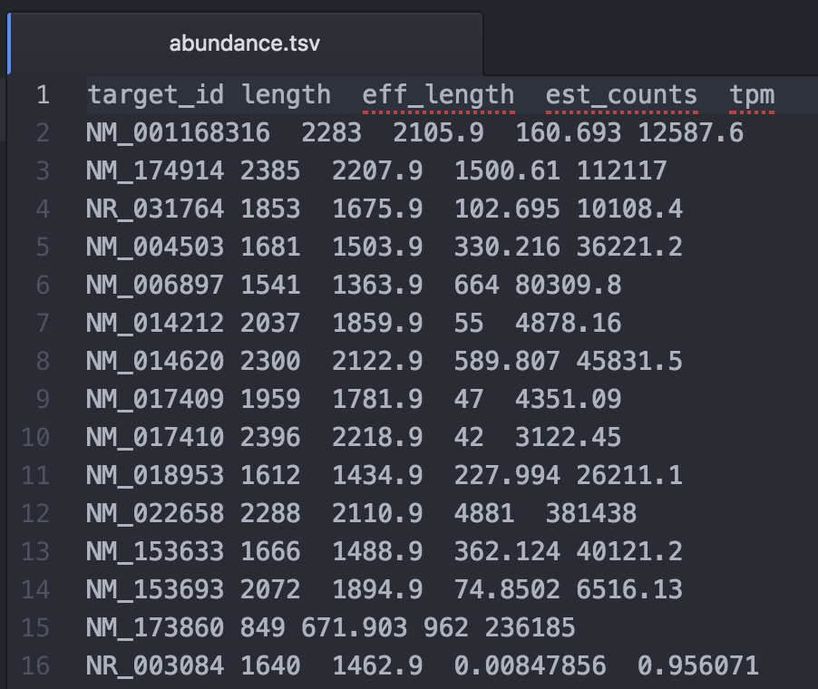
Data simulator
Notes:
cMESSi: A metagenomic simulator for the Illumina sequencing technology
We contacted the author, and he used the available data as well
Transcripts Per Million

Slide 33
Outline
1. Introduction
2. Methods and Results
3. Demonstration
4. Conclusion
5. Q&A

Slide 34
Conclusion
RNA-Seq methods for quantiﬁcation are also applicable in the metagenomics setting.
It is possible to accurately and rapidly quantify the abundance of individual strains.
The door is now open to metagenome analyses at the highest possible resolution.
Notes:
Our results show that RNA-Seq methods for quantication are also applicable in the metagenomics setting, and our results with kallisto demonstrate that it is possible to accurately and rapidly quantify the abundance of individual strains. most metagenomic analyses have focused on higher taxonomy, a point highlighted in the recent benchmarking paper [Lindgreen et al., 2015] which compares predictions at the phylum level because \[comparisons at that level are less prone to dierences“. The phylum level is four levels removed from genus, let alone species or strain. Our results suggests that the door is now open to metagenome analyses at the highest possible resolution.

Slide 35
The lack of attention paid to low taxonomic level analysis.
Spur others to standardize and organize naming conventions.
Notes:
One of the diculties we faced in our analyses was the technical issue of taxonomic naming and annotation in collating results. This seemingly trivial matter is complicated by the lack of attention paid to low taxonomic level analysis in previous methods. Hopefully our results will spur others to standardize and organize naming conventions and analysis

Slide 36
Outline
1. Introduction
2. Methods and Results
3. Demonstration
4. Conclusion
5. Q&A

Slide 37
Question lists
Q1. In order to test the hypothesis that RNA-Seq can be applied on metagenomics setting, the author examined eXpress, why they also compared the results of eXpress with GASiC?
A1. As we know, the author ran eXpress program to test the hypothesis mentioned before. It is clear that eXpress is a program for RNA-Seq, while GASiC is a program for metagenomics analysis. In the first approach, the author evaluated the result of eXpress on metagenomics, and it turned out to be better than GASiC, which means that hypothesis is thus confirmed.

Slide 38
Question lists
Q2. What is the meaning of ‘exact genome’ in terms of taxonomy?
A2. Across the paper, there are four taxonomic ranks, phylum, genus, species, and “exact genome” level. The exact genome is actually not a well-defined rank, which is a combination of strains and sub-strains. The purpose of adding this rank is because this paper wants to test the performance of kallisto and other algorithms in high taxonomic resolution.

Slide 39
Question lists
Q3. In the computation of AVGRE, why does it add 'T/A' term in the expression? Why is aligned reads not equal to total reads?
A3. See blackboard.

Slide 40
Question lists
Q5. Why are counts considered correctly assigned when they were less than or equal to true counts? What’s the logic in it?
A5: If the estimated counts are larger than the true counts, it is not correct.
05/17/17
40

